Slide 1


Automated VMware templates with packer
Denver PowerShellers

Slide 2
A tool for building virtual machines images
packer | the stages
builders
provisioners
post-processors
workstation
fusion
virtualbox
powershell
ansible
puppet
Vsphere
vagrant
atlas
builder
provisioner
post-processor
vmware workstation
powershell
vmware vsphere

Slide 3
packer | the steps
an empty VM is created in vmware workstation
an ISO is copied down and attached to the VM
an Autounattend.xml is placed in the floppy drive and connected to the VM
the Autounattend.xml contains “FirstLogonCommands” to configure WinRM
the VM is booted and uses the Autounattend.xml previously placed on the A:\ drive
WinRM is configured and packer connects to the VM
when WinRM becomes available, packer provisioners run
run all the things!
once complete packer uses the provided shutdown command to power-off the VM
1. builder
2. provisioner
3. post-processor
upload to vsphere

Slide 4
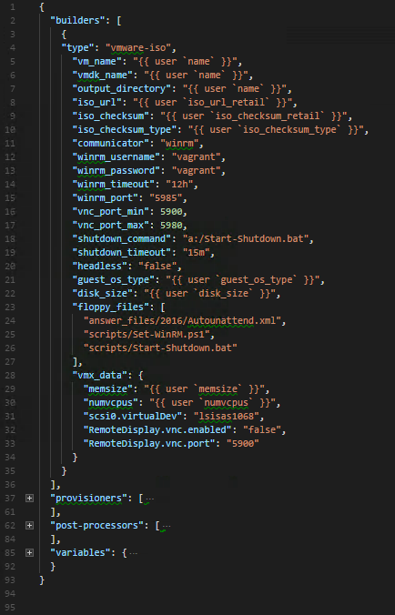

json
packer | the config file(s) aka “packer templates”
easy to read and a fun to write

Slide 5
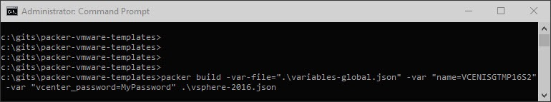
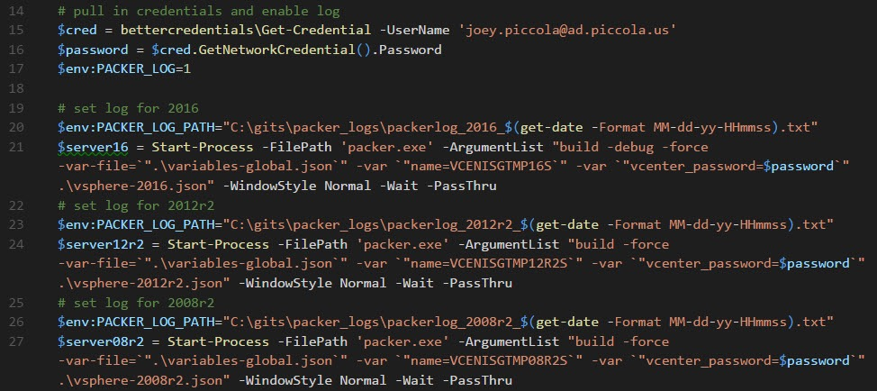
packer | run

Slide 6
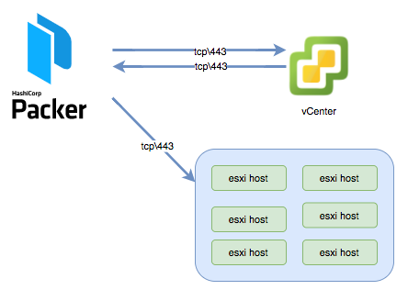
packer | vsphere post-processor network communication

